Slide 1

Intro to GitHub and GitHub Desktop
Last updated 10.6.24
Miranda DePriest

Slide 2
Some resources
GitHub:
(strongly recommend) https://github.com/skills/introduction-to-github?tab=readme-ov-file
https://docs.github.com/en/get-started/start-your-journey/hello-world
Git:
https://github.com/kuahyeow/git-workshop
Git glossary:
https://git-scm.com/docs/gitglossary

Slide 3



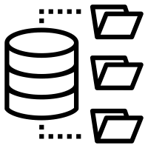



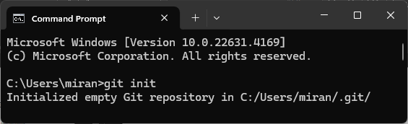



Git
Glossary
Git: the version control system
GitHub: the web platform
GitHub Desktop: the app
Repo: the project location
Fetch: Retrieves changes for review
Merge: Integrates changes
Pull: Retrieves changes and automatically integrates changes
Commit: Saves a version of the project
Push: Adds changes to the remote repo
Branch: a parallel version of your repo
a version control system
This is the method that Git tools use
Git install:
https://git-scm.com/downloads
Git icon

Slide 4
Git
Glossary
Git: the version control system
GitHub: the web platform
GitHub Desktop: the app
Repo: the project location
Fetch: Retrieves changes for review
Merge: Integrates changes
Pull: Retrieves changes and automatically integrates changes
Commit: Saves a version of the project
Push: Adds changes to the remote repo
Branch: a parallel version of your repo
a version control system
This is the method that Git tools use
Git install:
https://git-scm.com/downloads
Git icon

Slide 5
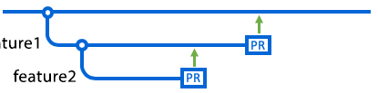
Why do we need these Git?
Glossary
Git: the version control system
GitHub: the web platform
GitHub Desktop: the app
Repo: the project location
Fetch: Retrieves changes for review
Merge: Integrates changes
Pull: Retrieves changes and automatically integrates changes
Commit: Saves a version of the project
Push: Adds changes to the remote repo
Branch: a parallel version of your repo
Projects evolve over time
You may need different versions for different purposes
We need to keep track of HOW we have changed our methods
You may want to TRY something without the risk of breaking your code
when the big changes were added
start
now
main branch
the first big change
the second big change

Slide 6

Why do we need these Git?
Glossary
Git: the version control system
GitHub: the web platform
GitHub Desktop: the app
Repo: the project location
Fetch: Retrieves changes for review
Merge: Integrates changes
Pull: Retrieves changes and automatically integrates changes
Commit: Saves a version of the project
Push: Adds changes to the remote repo
Branch: a parallel version of your repo
You may need to go back in time
back in the good ole days
when I BROKE it
start
main branch

Slide 7
How to use Git
Glossary
Git: the version control system
GitHub: the web platform
GitHub Desktop: the app
Repo: the project location
Fetch: Retrieves changes for review
Merge: Integrates changes
Pull: Retrieves changes and automatically integrates changes
Commit: Saves a version of the project
Push: Adds changes to the remote repo
Branch: a parallel version of your repo
You can create a Git repo for any project, including projects you’ve already started
Once installed, you can use Git through the command line
The commands are straight forward. Examples:
‘git init’ initializes a repository (where you put your project)
‘git commit’ commits your changes
‘git pull’ pulls from other branches/repositories
In combination with internal commands (‘cd’, ‘ls’, etc.) you can manage your project, collaborate with others, and preserve your work
But if you prefer graphical displays like me, there are great tools available!

Slide 8

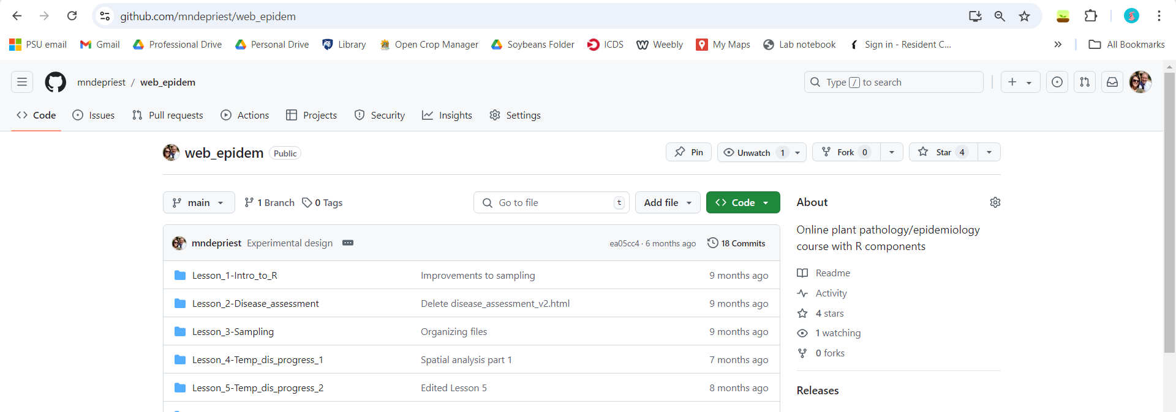
GitHub
Glossary
Git: the version control system
GitHub: the web platform
GitHub Desktop: the app
Repo: the project location
Fetch: Retrieves changes for review
Merge: Integrates changes
Pull: Retrieves changes and automatically integrates changes
Commit: Saves a version of the project
Push: Adds changes to the remote repo
Branch: a parallel version of your repo
A web platform for storing repositories, tracking their changes, and collaborating with others. It uses Git. github.com

Slide 9
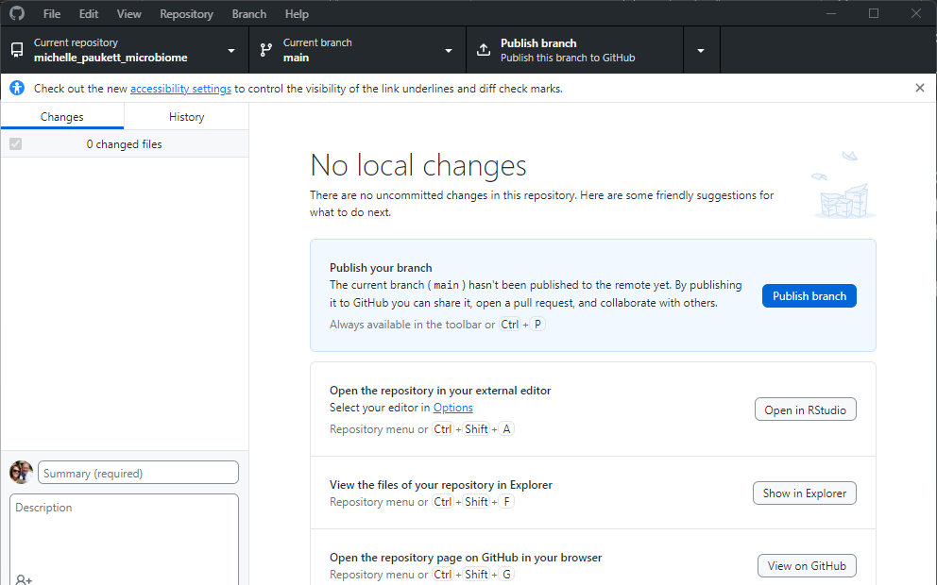
GitHub Desktop
Glossary
Git: the version control system
GitHub: the web platform
GitHub Desktop: the app
Repo: the project location
Fetch: Retrieves changes for review
Merge: Integrates changes
Pull: Retrieves changes and automatically integrates changes
Commit: Saves a version of the project
Push: Adds changes to the remote repo
Branch: a parallel version of your repo
An application for managing repositories on your local device. It uses Git.
Download: https://desktop.github.com/download/

Slide 10
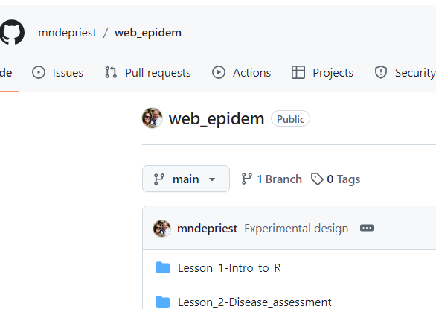
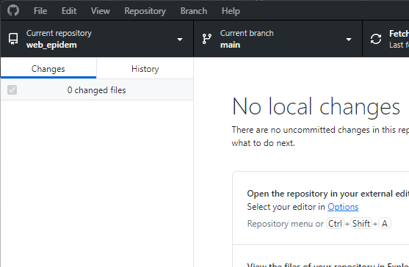
Repos
Glossary
Git: the version control system
GitHub: the web platform
GitHub Desktop: the app
Repo: the project location
Fetch: Retrieves changes for review
Merge: Integrates changes
Pull: Retrieves changes and automatically integrates changes
Commit: Saves a version of the project
Push: Adds changes to the remote repo
Branch: a parallel version of your repo
Repository (“repo”): the location where code, files, and other resources are kept

Slide 11


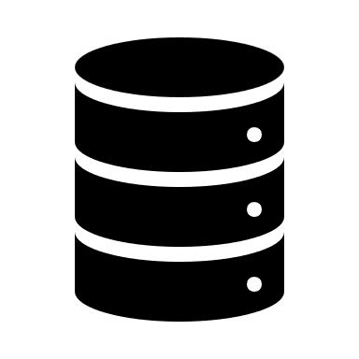
Remote vs. local repos
Glossary
Git: the version control system
GitHub: the web platform
GitHub Desktop: the app
Repo: the project location
Fetch: Retrieves changes for review
Merge: Integrates changes
Pull: Retrieves changes and automatically integrates changes
Commit: Saves a version of the project
Push: Adds changes to the remote repo
Branch: a parallel version of your repo
Remote repo: the central location where code is stored; the master copy
Allows for others to collaborate
The remote repo is the star of the show. This is what other people will see.
Local repo: the project on your local machine; where you change the code
Technically, you already have a repo. It’s your project folder. But it’s not linked to Git!
Remote repo
Your local repo
Your coworker’s local repo

Slide 12
Remote vs. local repos
Glossary
Git: the version control system
GitHub: the web platform
GitHub Desktop: the app
Repo: the project location
Fetch: Retrieves changes for review
Merge: Integrates changes
Pull: Retrieves changes and automatically integrates changes
Commit: Saves a version of the project
Push: Adds changes to the remote repo
Branch: a parallel version of your repo
Git doesn’t automatically sync changes between the remote and local repos. If it did, you couldn’t work on your local repo without destabilizing the remote repo.
You need to manually do this. This is where terms like ‘push’, ‘pull’, ‘fetch’, and more come from.
Remote repo
Your local repo
Your coworker’s local repo

Slide 13
Getting started: Creating a remote repo
Glossary
Git: the version control system
GitHub: the web platform
GitHub Desktop: the app
Repo: the project location
Fetch: Retrieves changes for review
Merge: Integrates changes
Pull: Retrieves changes and automatically integrates changes
Commit: Saves a version of the project
Push: Adds changes to the remote repo
Branch: a parallel version of your repo
You can create a new project with Git through the command line (command: git init) or with GitHub or GitHub Desktop.
You can start an entirely new project with nothing in it or you can create a repo for a project you’re already working on.
Notes:
https://github.com/mndepriest?tab=repositories

Slide 14
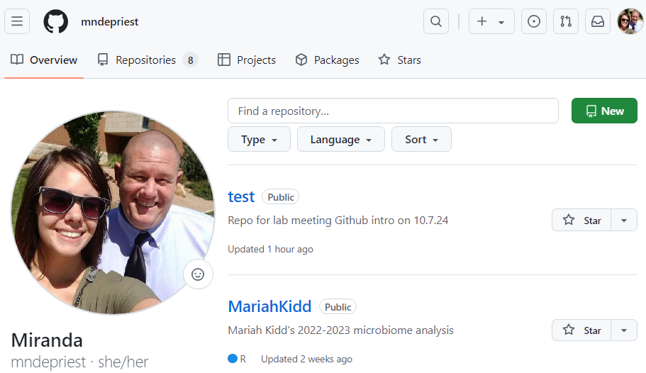
Creating a repo - GitHub
Glossary
Git: the version control system
GitHub: the web platform
GitHub Desktop: the app
Repo: the project location
Fetch: Retrieves changes for review
Merge: Integrates changes
Pull: Retrieves changes and automatically integrates changes
Commit: Saves a version of the project
Push: Adds changes to the remote repo
Branch: a parallel version of your repo
Create an entirely new project
Repositories -> New
Notes:
https://github.com/mndepriest?tab=repositories

Slide 15
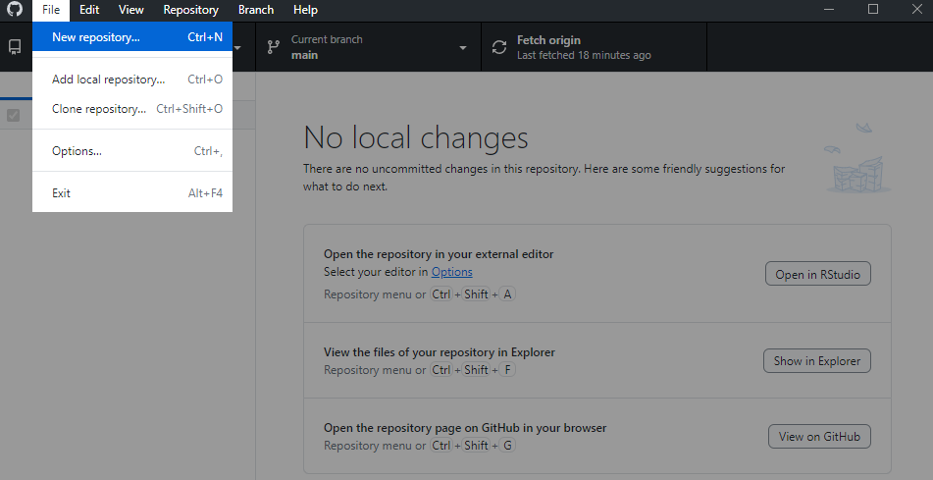
Creating a repo – GitHub Desktop
Glossary
Git: the version control system
GitHub: the web platform
GitHub Desktop: the app
Repo: the project location
Fetch: Retrieves changes for review
Merge: Integrates changes
Pull: Retrieves changes and automatically integrates changes
Commit: Saves a version of the project
Push: Adds changes to the remote repo
Branch: a parallel version of your repo
Create an entirely new project
File -> New Repository
Notes:
https://github.com/mndepriest?tab=repositories

Slide 16
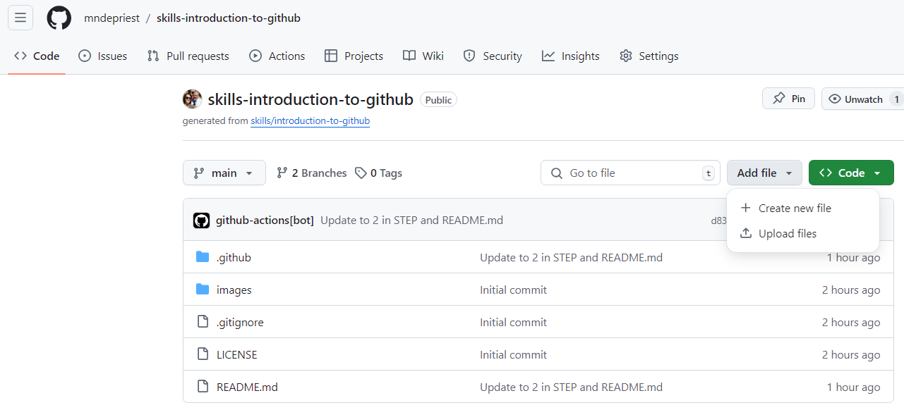
If you already have a project folder (local repo) - GitHub
Glossary
Git: the version control system
GitHub: the web platform
GitHub Desktop: the app
Repo: the project location
Fetch: Retrieves changes for review
Merge: Integrates changes
Pull: Retrieves changes and automatically integrates changes
Commit: Saves a version of the project
Push: Adds changes to the remote repo
Branch: a parallel version of your repo
When you already have stuff for your project create a new project and then upload its files
Notes:
https://github.com/mndepriest?tab=repositories

Slide 17
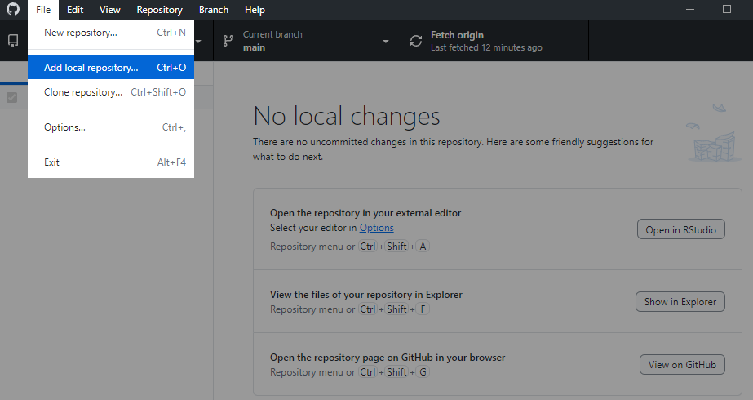
If you already have a project folder (local repo) - GitHub
Glossary
Git: the version control system
GitHub: the web platform
GitHub Desktop: the app
Repo: the project location
Fetch: Retrieves changes for review
Merge: Integrates changes
Pull: Retrieves changes and automatically integrates changes
Commit: Saves a version of the project
Push: Adds changes to the remote repo
Branch: a parallel version of your repo
Notes:
https://github.com/mndepriest?tab=repositories

Slide 18
If you have a remote repo but no local repo
Glossary
Git: the version control system
GitHub: the web platform
GitHub Desktop: the app
Repo: the project location
Fetch: Retrieves changes for review
Merge: Integrates changes
Pull: Retrieves changes and automatically integrates changes
Commit: Saves a version of the project
Push: Adds changes to the remote repo
Branch: a parallel version of your repo
You will ‘clone’ the remote repo and make a copy on your local device.
Cloning: the initial install of a remote repo locally
You currently can’t do this with only GitHub. You need to work in the command line or with GitHub Desktop.
In the command line:
Get the repo’s URL
Open Git Bash/Command Prompt
Navigate to the desired local directory
git clone <repository URL>
Notes:
https://github.com/mndepriest?tab=repositories

Slide 19
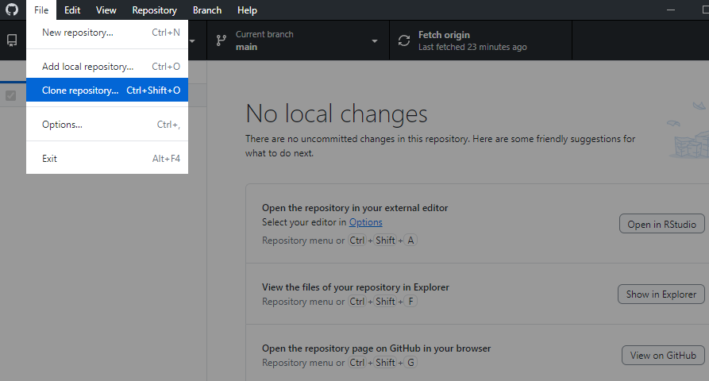
If you have a remote repo but no local repo
Glossary
Git: the version control system
GitHub: the web platform
GitHub Desktop: the app
Repo: the project location
Fetch: Retrieves changes for review
Merge: Integrates changes
Pull: Retrieves changes and automatically integrates changes
Commit: Saves a version of the project
Push: Adds changes to the remote repo
Branch: a parallel version of your repo
You can do this more easily with GitHub Desktop
Notes:
https://github.com/mndepriest?tab=repositories

Slide 20


Updating your LOCAL repo
Glossary
Git: the version control system
GitHub: the web platform
GitHub Desktop: the app
Repo: the project location
Fetch: Retrieves changes for review
Merge: Integrates changes
Pull: Retrieves changes and automatically integrates changes
To update your local repo with material from your remote repo:
Fetch: Gets changes from the remote repo
and
Merge: Merges changes into your current branch
OR
Pull: Gets changes from the remote repo and merges them into your current branch
Option 1: Safer
Option 2: Faster
Fetch
Look at the changes
Merge
Pull

Slide 21
Updating your REMOTE repo
Glossary
Git: the version control system
GitHub: the web platform
GitHub Desktop: the app
Repo: the project location
Fetch: Retrieves changes for review
Merge: Integrates changes
Pull: Retrieves changes and automatically integrates changes
Commit: Saves a version of the project
Push: Adds changes to the remote repo
To update the remote repo after making changes in the local repo:
Commit: to create a ‘saved’ version of your project with an explanation of what was changed.
Push*: to upload changes to the remote repo
When you make a commit, you create a version history.
When you push your changes, others can access them from the remote repo.
* Push is also used when adding changes from other branches to the remote repo.
Commit
Push

Slide 22
Working on different version
Glossary
Git: the version control system
GitHub: the web platform
GitHub Desktop: the app
Repo: the project location
Fetch: Retrieves changes for review
Merge: Integrates changes
Pull: Retrieves changes and automatically integrates changes
Commit: Saves a version of the project
Push: Adds changes to the remote repo
Branch: a parallel version of your repo
Branch: a parallel version of your repo
Branches let you implement changes without impacting the overall project
By default, you have a main branch.

Slide 23

Working on different versions
Glossary
Git: the version control system
GitHub: the web platform
GitHub Desktop: the app
Repo: the project location
Fetch: Retrieves changes for review
Merge: Integrates changes
Pull: Retrieves changes and automatically integrates changes
Commit: Saves a version of the project
Push: Adds changes to the remote repo
Branch: a parallel version of your repo
Branch: a parallel version of your repo
For us, branches are most used when another person is working on your project
main branch
Paul’s branch
Dilooshi’s branch

Slide 24
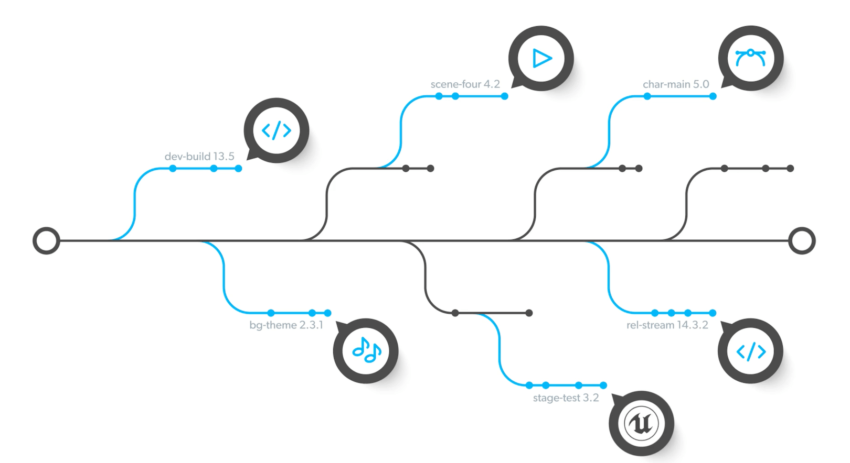
You can even branch branches!
If you don’t like a branch, you don’t have to delete it or merge it. Just ignore it.

Slide 25
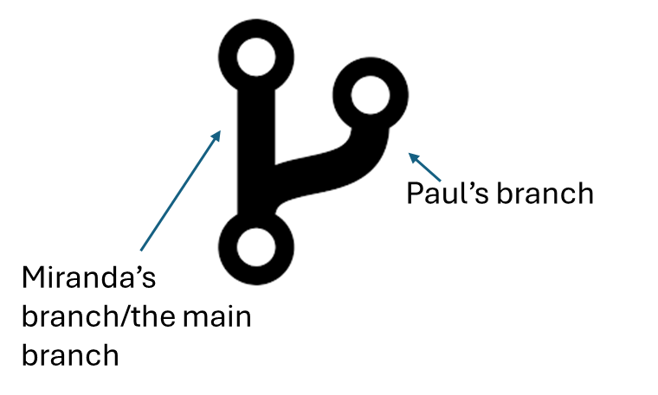
Branching gets confused with forking
Glossary
Git: the version control system
GitHub: the web platform
GitHub Desktop: the app
Repo: the project location
Fetch: Retrieves changes for review
Merge: Integrates changes
Pull: Retrieves changes and automatically integrates changes
Commit: Saves a version of the project
Push: Adds changes to the remote repo
Branch: a parallel version of your repo
Branch/branching: a separate line of development within the repo
Fork/forking: creating a copy of another person’s repo for your own use
Note – some of the less important things aren’t getting added to the glossary. You can find a complete version of the glossary at the end.
Miranda’s repo
Paul’s copy of Miranda’s repo

Slide 26

Branch actions
Glossary
Git: the version control system
GitHub: the web platform
GitHub Desktop: the app
Repo: the project location
Fetch: Retrieves changes for review
Merge: Integrates changes
Pull: Retrieves changes and automatically integrates changes
Commit: Saves a version of the project
Push: Adds changes to the remote repo
Branch: a parallel version of your repo
You may want to implement stuff from a branch into the main branch of your project
Pull request (PR): A request that the repo owner asking that your branch is implemented in the main branch
Merge: Approving a pull request and implementing the branch into the main
In this example, Dilooshi asked Paul to implement her branch, and then Paul asked me to implement his branch. The final main branch has all their changes.
main branch
Paul’s branch
Dilooshi’s branch

Slide 27
GitHub as a resource
Glossary
Git: the version control system
GitHub: the web platform
GitHub Desktop: the app
Repo: the project location
Fetch: Retrieves changes for review
Merge: Integrates changes
Pull: Retrieves changes and automatically integrates changes
Commit: Saves a version of the project
Push: Adds changes to the remote repo
Branch: a parallel version of your repo
You can find information on other, public repos on GitHub, including software packages
Information available:
README – contains instructions/background information about the repo
Subfolders can contain information about updates, how functions work, how the repo works in other languages, etc.
Examples:
https://github.com/zdk123/SpiecEasi
https://github.com/zdk123/SpiecEasi/blob/master/R/plotNet.R

Slide 28
Managing collaborators/privacy settings
Glossary
Git: the version control system
GitHub: the web platform
GitHub Desktop: the app
Repo: the project location
Fetch: Retrieves changes for review
Merge: Integrates changes
Pull: Retrieves changes and automatically integrates changes
Commit: Saves a version of the project
Push: Adds changes to the remote repo
Branch: a parallel version of your repo
You can add others to your repo
From GitHub: [name of your repo] -> Settings -> Collaborators -> Add people
You can also change the privacy settings.
From GitHub: [name of your repo] -> Settings -> Collaborators

Slide 29
Take-aways
Glossary
Git: the version control system
GitHub: the web platform
GitHub Desktop: the app
Repo: the project location
Fetch: Retrieves changes for review
Merge: Integrates changes
Pull: Retrieves changes and automatically integrates changes
Commit: Saves a version of the project
Push: Adds changes to the remote repo
Branch: a parallel version of your repo
You learned the fundamentals of GitHub or died trying.
With GitHub, you can:
Back up your projects
Try new things without worrying about breaking stuff
Share code with others
Ensure the reproducibility of your work
Easily keep a record of the changes you’ve made/what you used when you started
Next, I strongly recommend you do this tutorial. You’ll be guided through creating and managing a repo.

